Slide 1

Velocity – Time Graphs
We will interpret velocity – time graphs
Notes:
Insert cover image and use transparency settings to fade image.

Slide 2
Do not delete this slide.
This slide is designed so that you can copy the prompt box you need and insert it into your slides.
This slide is hidden and will not be included when presenting your lesson.
TRACK WITH ME
VOCABULARY
1 -
HINT
Students, remember….
CHECK FOR UNDERSTANDING
READ WITH ME
TEACHER CUE
MAKE THE CONNECTION
Students, you already know….
EXTENSION
GESTURE WITH ME

Slide 3

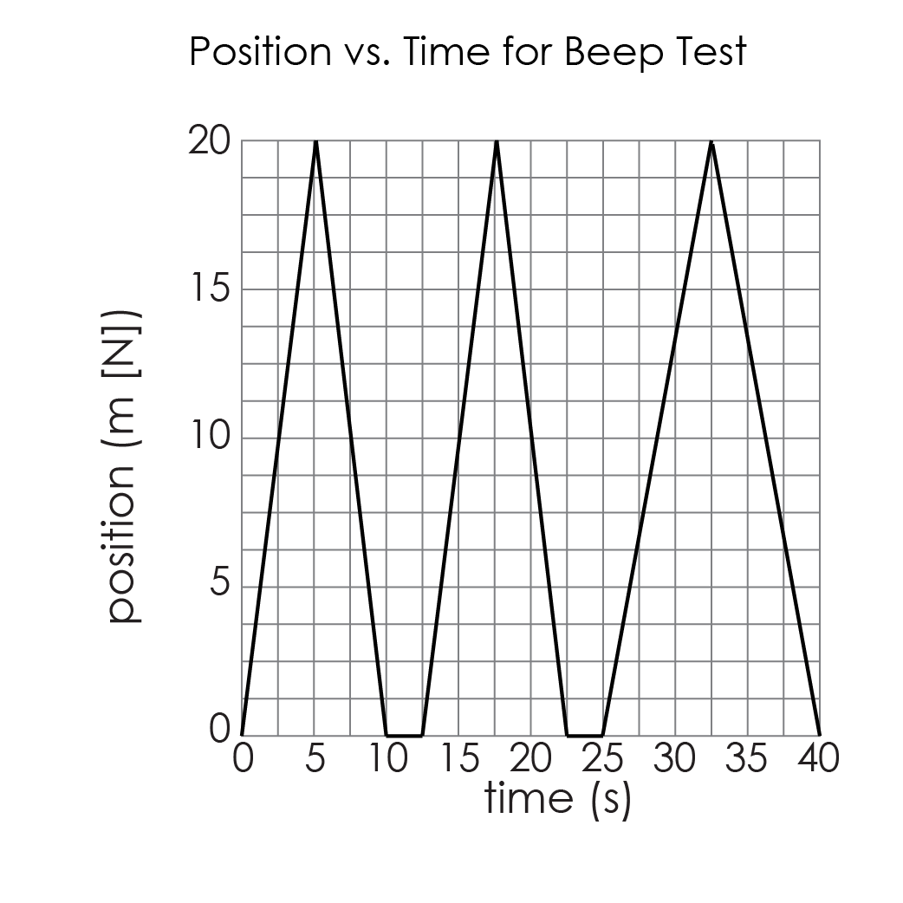
            DO NOW
7 minutes
Q1. Examine the graph.
Use the title and axes to write a description of the runner’s motion.
What is the position of the runner after 5 s?
When is the runner stopped?
Determine the runner’s average velocity for the time interval between 5 s and 10 s.
Determine the runner’s average velocity for the time interval between 32.5 s and 40 s.
Interpret the sign of this value.

Slide 4
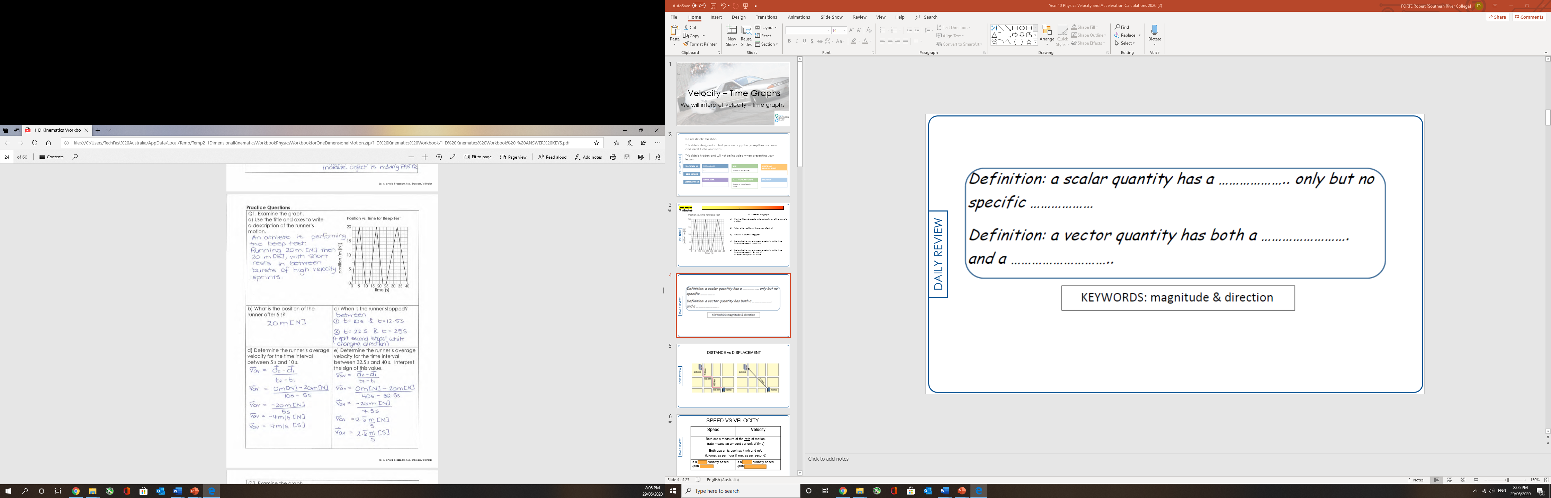

Slide 8
We will interpret velocity – time graphs
TRACK WITH ME
READ WITH ME
Describe the motion at various stages of a velocity time graph
We will calculate the acceleration from the gradient of a velocity-time graph
We will calculate displacement from a velocity-time graph
DECLARE THE OBJECTIVE
Read the learning objective to your partner.
Notes:
Learning Objectives contain concepts (nouns, big ideas), skills (verbs, measurable behaviours) and sometimes context (restricting or targeting conditions).
●Example: Students will be able to describe the concept of density and apply it to floating and sinking.
●
Success criteria are specific measurable outcomes that if met mean that the student has met the learning objective.
Examples:
•Students will be able to compare densities of substances using mass and volume.
•Students will be able to identify whether a solid or liquid will float or sink in a liquid based on their densities.

Slide 9
We will interpret velocity – time graphs
For all velocity-time graphs, time is the independent variable (along the horizontal axis) and velocity is the dependent variable (along the vertical axis).
For a velocity-time graph there are only three skills needed to properly analyze the graph:
Reading values off the graph.
Finding the slope of the graph.
Finding the area underneath the graph.

Slide 10
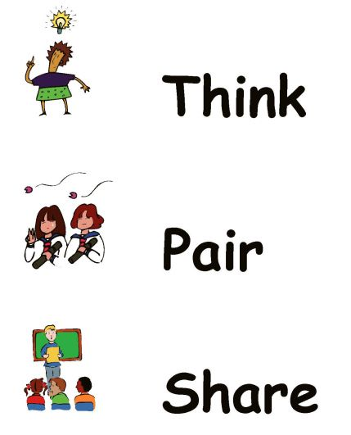
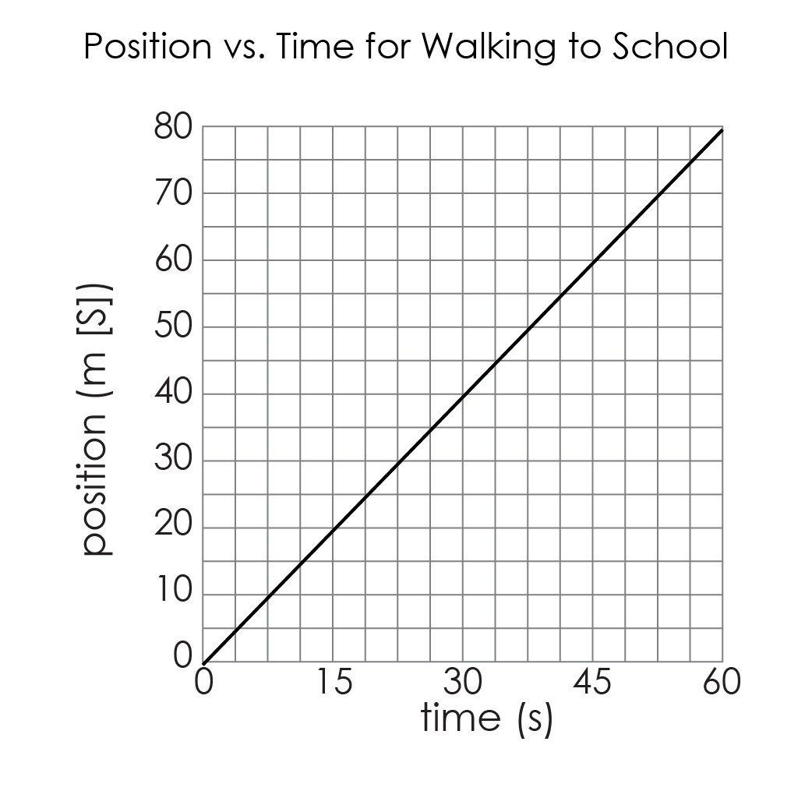
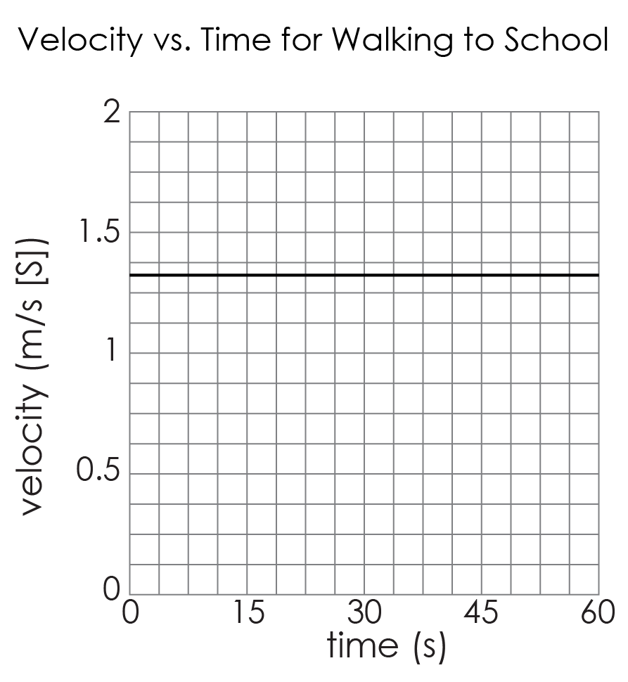
We will interpret velocity – time graphs
The two graphs below represent the same situation:
a student walking to school, 80 m [S] from home, at a constant velocity of 1.33 m/s [S].
Similarities
Differences

Slide 11
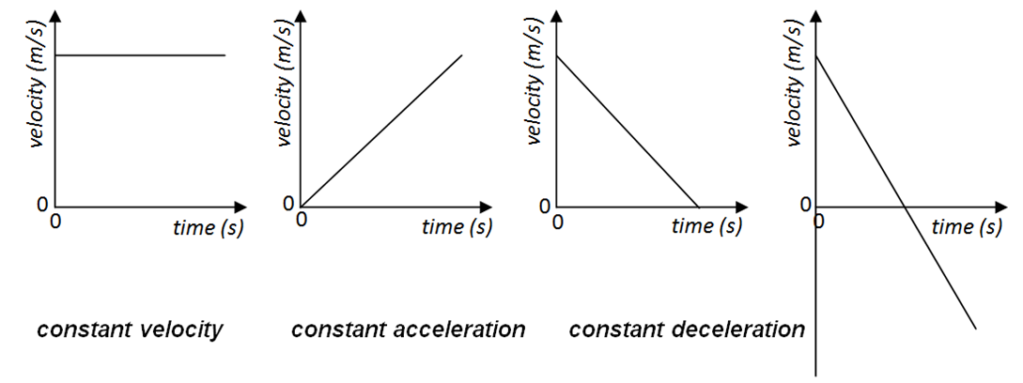
We will interpret velocity – time graphs
Interpreting velocity-time graphs

Slide 12
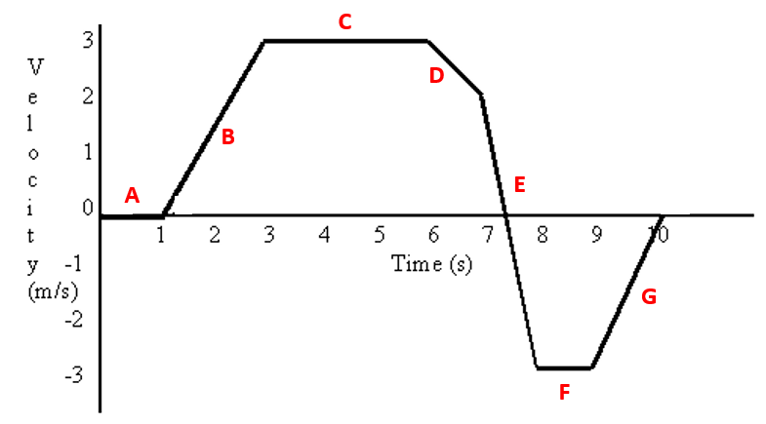
Task 1 - Velocity-Time Graphs
Key Words – velocity, time, graph, m/s, acceleration, m/s², gradient, distance, motion, deceleration, stationary, constant velocity, area, tangent, constant acceleration
Glue the velocity-time graph into your exercise book and describe the motion at each part.
Calculate the acceleration where necessary.
Extension – what was the average acceleration in the first 6 seconds?

Slide 13
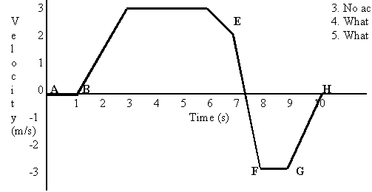
Key Words – velocity, time, graph, m/s, acceleration, m/s², gradient, distance, motion, deceleration, stationary, constant velocity, area, tangent, constant acceleration
C
D
A = the object is stationary for 1 second.
B
E
A
G
F
Notes:
Image - http://hrsbstaff.ednet.ns.ca/dawsonrj/10%20Science/Physics/Motion/velocity%20time%20graphs%20introduction.htm

Slide 14
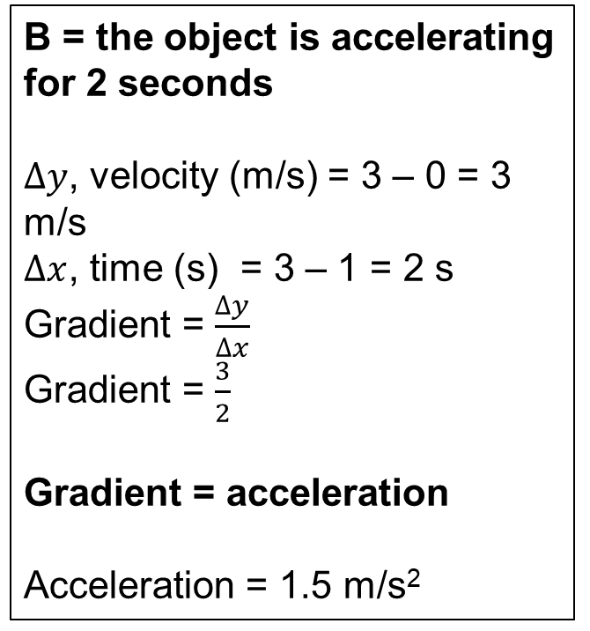
Key Words – velocity, time, graph, m/s, acceleration, m/s², gradient, distance, motion, deceleration, stationary, constant velocity, area, tangent, constant acceleration
B = the object is accelerating for 2 seconds
$∆y$, velocity (m/s) = 3 – 0 = 3 m/s
$∆x$, time (s) = 3 – 1 = 2 s
Gradient = $\frac{∆y}{∆x}$
Gradient = $\frac{3}{2}$
Gradient = acceleration
Acceleration = 1.5 m/s²
C
D
B
E
A
G
F
Notes:
Image - http://hrsbstaff.ednet.ns.ca/dawsonrj/10%20Science/Physics/Motion/velocity%20time%20graphs%20introduction.htm

Slide 15
Key Words – velocity, time, graph, m/s, acceleration, m/s², gradient, distance, motion, deceleration, stationary, constant velocity, area, tangent, constant acceleration
C
D
C = the object is travelling at a constant velocity for 3 seconds
B
E
A
G
F
Notes:
Image - http://hrsbstaff.ednet.ns.ca/dawsonrj/10%20Science/Physics/Motion/velocity%20time%20graphs%20introduction.htm

Slide 16
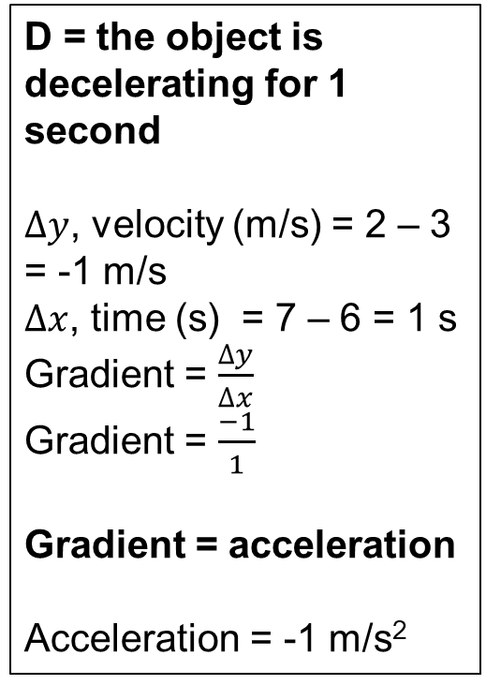
Key Words – velocity, time, graph, m/s, acceleration, m/s², gradient, distance, motion, deceleration, stationary, constant velocity, area, tangent, constant acceleration
D = the object is decelerating for 1 second
$∆y$, velocity (m/s) = 2 – 3 = -1 m/s
$∆x$, time (s) = 7 – 6 = 1 s
Gradient = $\frac{∆y}{∆x}$
Gradient = $\frac{−1}{1}$
Gradient = acceleration
Acceleration = -1 m/s²
C
D
B
E
A
G
F
Notes:
Image - http://hrsbstaff.ednet.ns.ca/dawsonrj/10%20Science/Physics/Motion/velocity%20time%20graphs%20introduction.htm

Slide 17
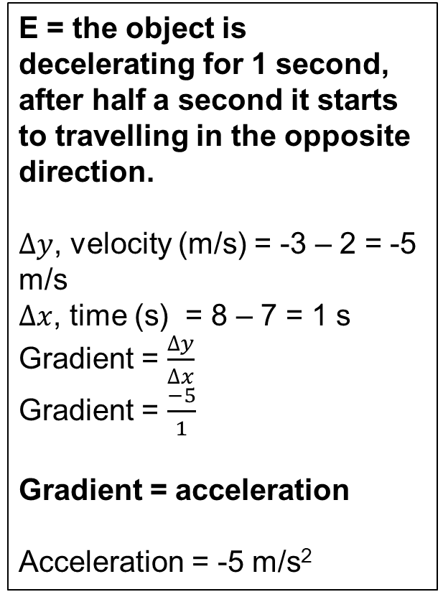
Key Words – velocity, time, graph, m/s, acceleration, m/s², gradient, distance, motion, deceleration, stationary, constant velocity, area,, tangent, constant acceleration
E = the object is decelerating for 1 second, after half a second it starts to travelling in the opposite direction.
$∆y$, velocity (m/s) = -3 – 2 = -5 m/s
$∆x$, time (s) = 8 – 7 = 1 s
Gradient = $\frac{∆y}{∆x}$
Gradient = $\frac{−5}{1}$
Gradient = acceleration
Acceleration = -5 m/s²
C
D
B
E
A
G
F
Notes:
Image - http://hrsbstaff.ednet.ns.ca/dawsonrj/10%20Science/Physics/Motion/velocity%20time%20graphs%20introduction.htm

Slide 18
Key Words – velocity, time, graph, m/s, acceleration, m/s², gradient, distance, motion, deceleration, stationary, constant velocity, area, tangent, constant acceleration
C
D
F = the object is travelling at a constant velocity for 1 second
B
E
A
G
F
Notes:
Image - http://hrsbstaff.ednet.ns.ca/dawsonrj/10%20Science/Physics/Motion/velocity%20time%20graphs%20introduction.htm

Slide 19
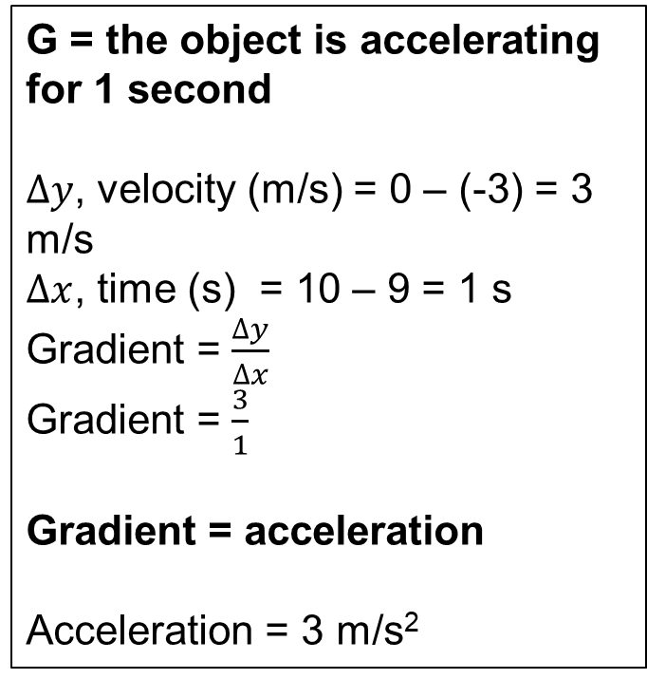
Key Words – velocity, time, graph, m/s, acceleration, m/s², gradient, distance, motion, deceleration, stationary, constant velocity, area, tangent, constant acceleration
C
G = the object is accelerating for 1 second
$∆y$, velocity (m/s) = 0 – (-3) = 3 m/s
$∆x$, time (s) = 10 – 9 = 1 s
Gradient = $\frac{∆y}{∆x}$
Gradient = $\frac{3}{1}$
Gradient = acceleration
Acceleration = 3 m/s²
D
B
E
A
G
F
Notes:
Image - http://hrsbstaff.ednet.ns.ca/dawsonrj/10%20Science/Physics/Motion/velocity%20time%20graphs%20introduction.htm

Slide 20
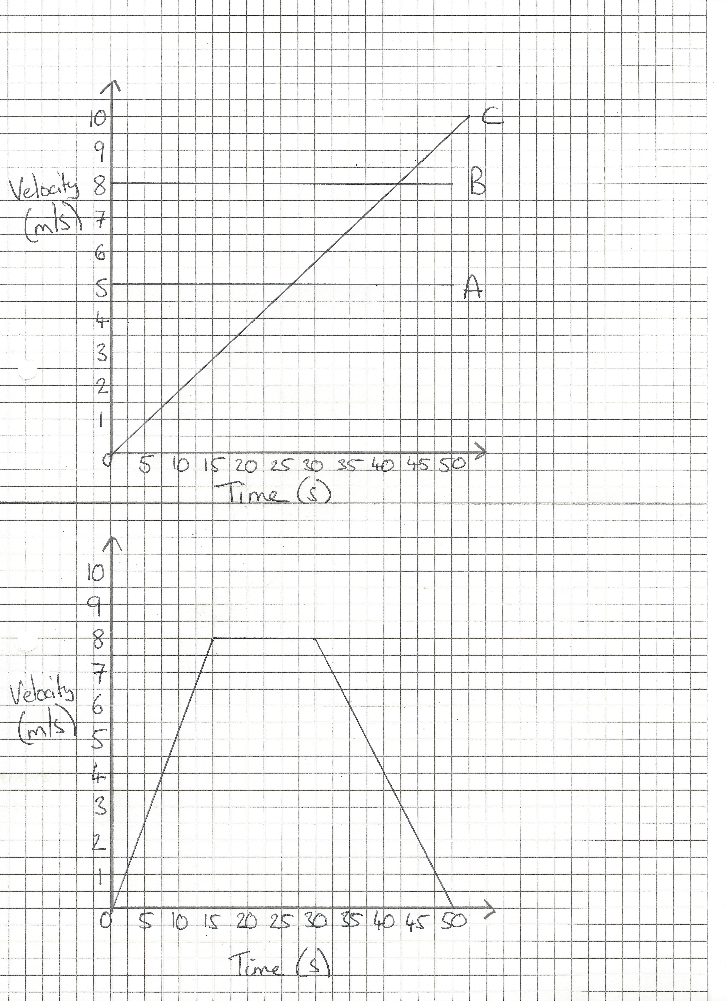
The distance travelled is equal to the area under the graph.
Area = base x height
Area = 50 s x 5 m/s
Area = 250 m
Distance travelled = 250 m

Slide 21
The distance travelled is equal to the area under the graph.
Area = base x height
Area = 50 s x 8 m/s
Area = 400 m
Distance travelled = 400 m

Slide 22
The distance travelled is equal to the area under the graph.
Area = ½ x base x height
Area = ½ x 52.5 s x 10 m/s
Area = 262.5 m
Distance travelled = 262.5 m

Slide 23
Task 2 – Calculating the distance travelled
Key Words – velocity, time, graph, m/s, acceleration, m/s², gradient, distance, motion, deceleration, stationary, constant velocity, area, tangent, constant acceleration
Calculate the distance the vehicle travelled from the velocity-time graph.
Hint – you will need to split the graph into three sections.
Extension – calculate the acceleration in the first 15 seconds and the last 20 seconds.

Slide 24
We will interpret velocity – time graphs
Summary: For a velocity-time graph
Reading the graph | Finding the slope | Finding the area
Gives the velocity
Gives the acceleration
Gives the displacement

Slide 25

Complete:
Velocity – Time Graphs Lesson
Due FRIDAY

Slide 26
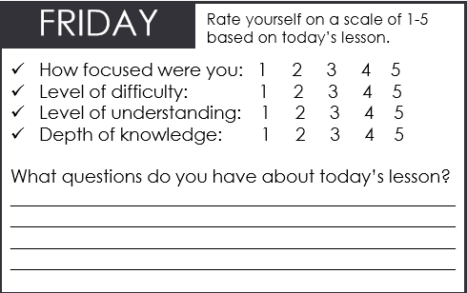

We will interpret velocity – time graphs
TRACK WITH ME
READ WITH ME
Describe the motion at various stages of a velocity time graph
We will calculate the acceleration from the gradient of a velocity-time graph
We will calculate displacement from a velocity-time graph
Notes:
Learning Objectives contain concepts (nouns, big ideas), skills (verbs, measurable behaviours) and sometimes context (restricting or targeting conditions).
●Example: Students will be able to describe the concept of density and apply it to floating and sinking.
●
Success criteria are specific measurable outcomes that if met mean that the student has met the learning objective.
Examples:
•Students will be able to compare densities of substances using mass and volume.
•Students will be able to identify whether a solid or liquid will float or sink in a liquid based on their densities.

Slide 27
Enter Learning Objective
Complete the Homework questions on these calculations
Add picture

Slide 28
Enter Learning Objective
CHECK FOR UNDERSTANDING
VOCABULARY

Slide 29
Enter Learning Objective
Task
Task
CHECK FOR UNDERSTANDING
HINT
Students, remember….
VOCABULARY
Notes:
Please include tasks/questions here rather than just referring to a worksheet. This will save on photocopying and facilitate sharing with other schools.
Try and build tasks/questions which escalate through Bloom’s Taxonomy. This will help with differentiation.

